Slide 1
Fluid substitution effects on seismic anisotropy
Long Huang, Robert Stewart, Samik Sil, and Nikolay Dyaur
Houston
April 2nd, 2014

Slide 2
Outline
Motivation
Natural fractures and anisotropy, fluid effects
Theory and methods
Anisotropic Gassmann’s equations, parameterize,
recast Gassmann’s equations
Discussions
P- & S-wave moduli and velocities, Thomsen’s parameters,
azimuthal amplitude variation
Conclusions

Slide 3
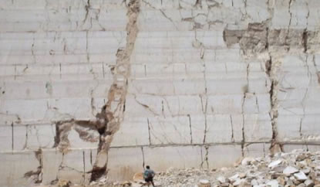
Fractures
The deformation in carbonates rocks
Beautiful fractured Atoka Sandstone at Natural Dam.
(http://www.rechproject.com/related-project.html)
(Liner, 2013)
HTI
Orthorhombic
X
X
Y
Y
Z
Z
(Huang et al., 2013)
How to characterize these fractured rocks?
How would fluid influence their physical properties?
How about seismic anisotropy with different fluids?

Slide 4
Theory
X
Y
Z
Fluid term
Dry term
Fluid term
Dry term
(Gassmann, 1951)
(Gassmann, 1951)
(Schoenberg, 1980; Schoenberg and Sayers, 1995;
Bukulin et al., 2000)

Slide 5
The complete recipe

Slide 6
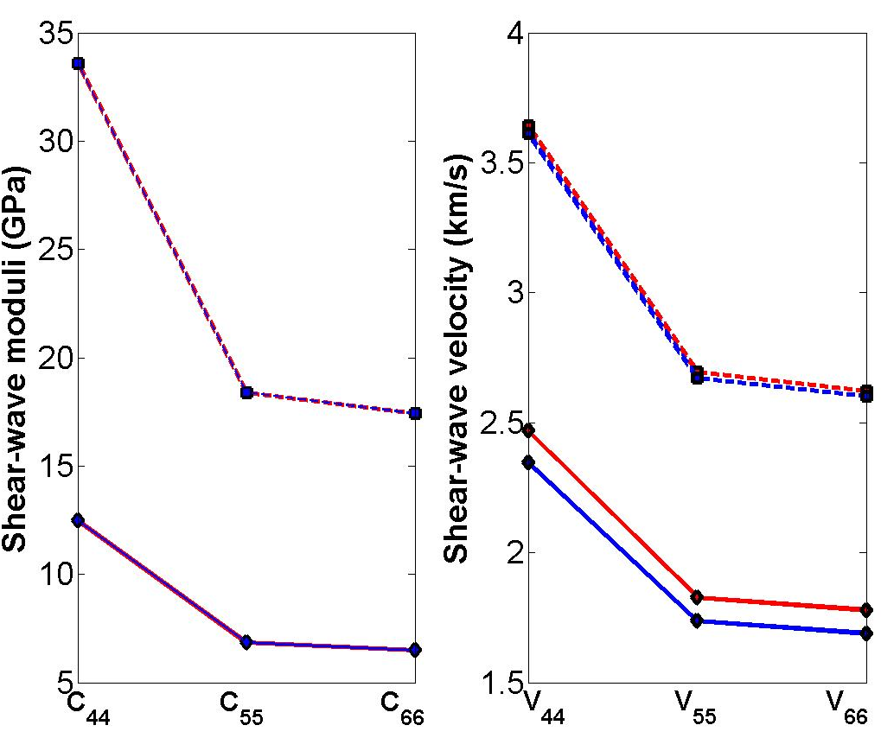
Gas to brine substitution: S-waves
Φ=5%
Φ=25%
Φ=5%
Red is for gas
Blue is for brine
Φ=5%
Φ=25%
Φ=25%
Shear-wave moduli are independent of fluid type
Shear-wave velocities depend on fluid type due to density change

Slide 7
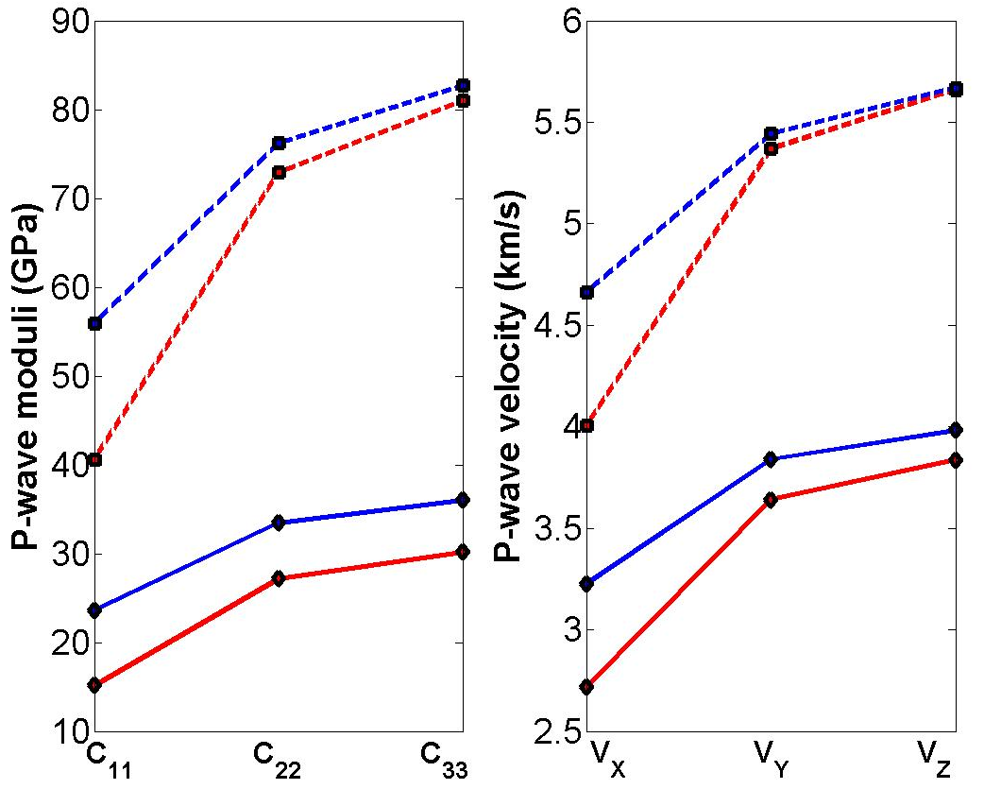
Gas to brine substitution: P-wave
Φ=5%
brine
Φ=5%
brine
Φ=5%
Φ=25%
Red is for gas
Blue is for brine
gas
gas
Φ=5%
X
brine
Y
brine
Φ=25%
Z
Φ=25%
gas
gas
Φ=25%
Porosity (φ) | Δ C₁₁ | Δ C₂₂ | Δ C₃₃
5% | 38% | 5% | 2%
25% | 56% | 23% | 19%
Porosity (φ) | Δ V_{px} | Δ V_{py} | Δ V_{pz}
5% | 16% | 1% | 0%
25% | 19% | 6% | 4%
Fluid substitution effects on P-wave are anisotropic
P-wave moduli of high-porosity sands are more sensitive to fluids
Vertical P-wave velocity of low-porosity sands is constant with fluids

Slide 8
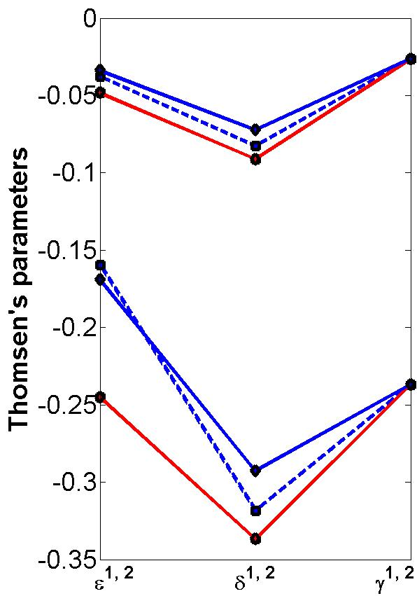
Gas to brine substitution: Thomsen’s parameters
Porosity (φ) | Δ ε¹ | Δ δ¹ | Δ ε² | Δ δ²
5% | -22% | -9% | -5 % | -35 %
25% | -30% | -20% | -13% | -31%
(1)
brine
gas
YZ plane
XZ plane
brine
(Bakulin et al., 2000)
(2)
X
X
gas
Y
Y
Z
Z
Φ=5%
Φ=25%
Red is for gas
Blue is for brine
Shear-wave splitting (γ) is independent on fluids
Both ε and δ are sensitive to fluids

Slide 9
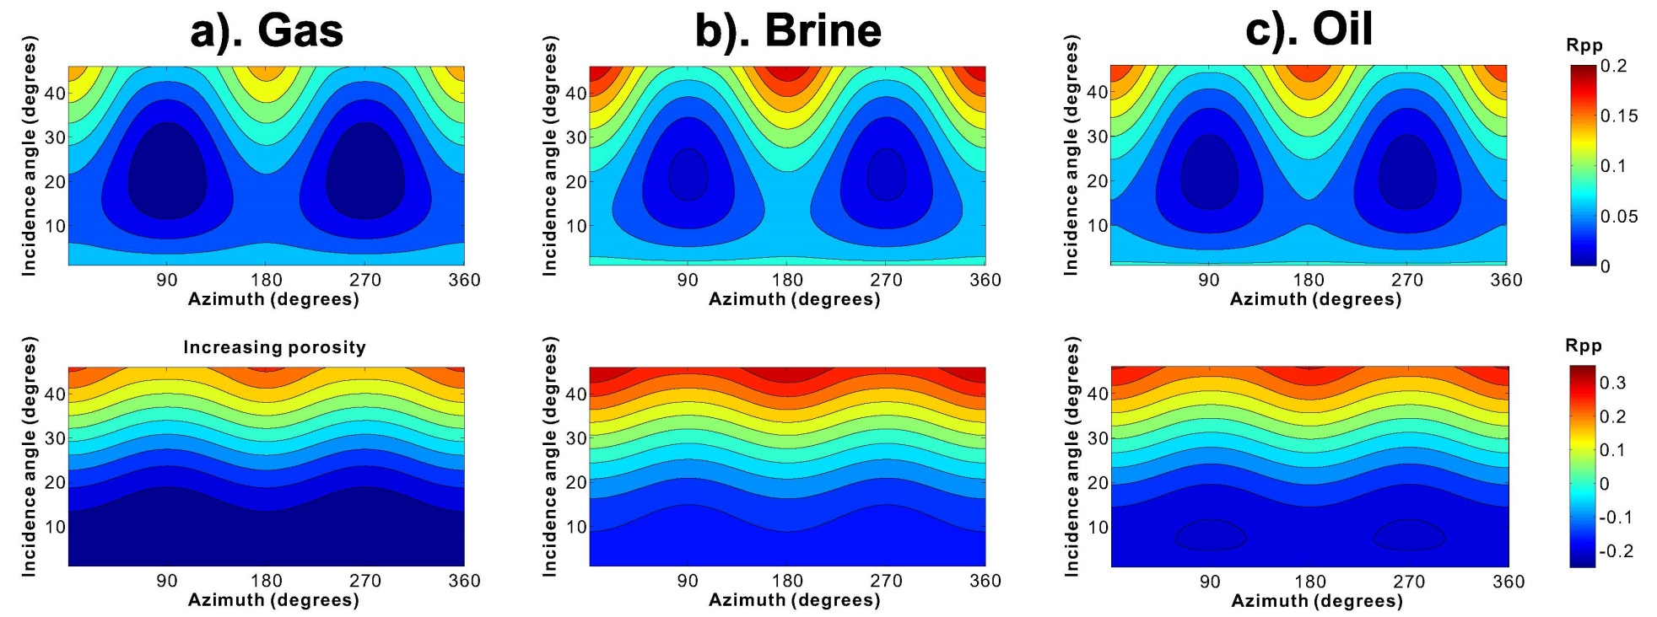
Gas to brine substitution: AVAZ
P-wave reflectivity
Y (90°)
(180°)
X (0°)
Shale
Sandstone
Porosity (φ) | Δ AVAZ (30°)
5% | 12%
25% | -6%
(Azimuth versus incidence angle)
(Rpp calculated from Václav Vavryčuk and Ivan Pšenčík, 1998)
High-porosity: gas sands have more azimuthal amplitude variations
Low-porosity: wet sands have more azimuthal amplitude variations

Slide 10
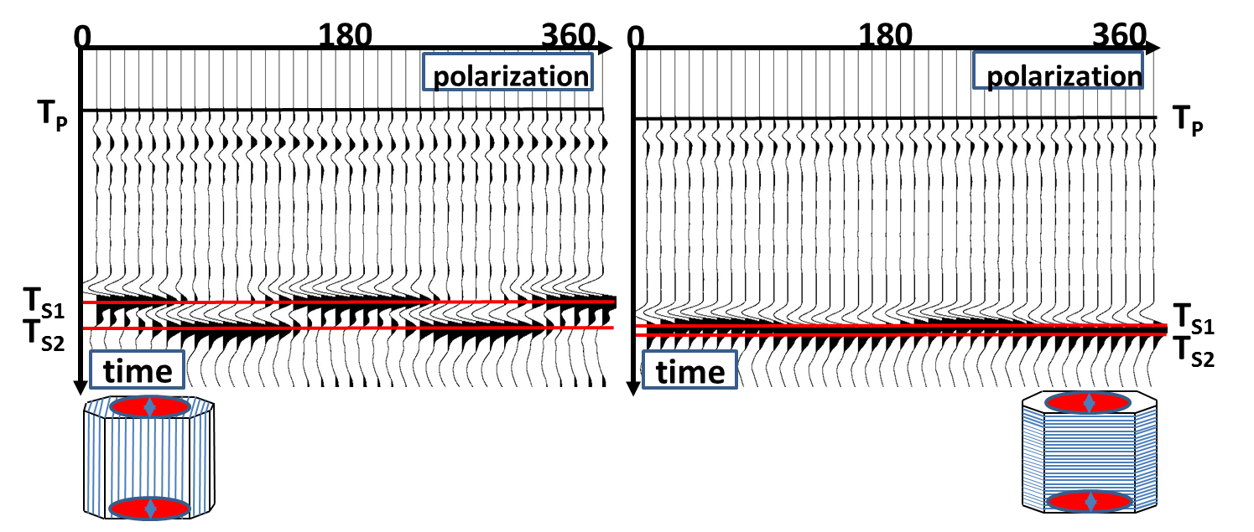
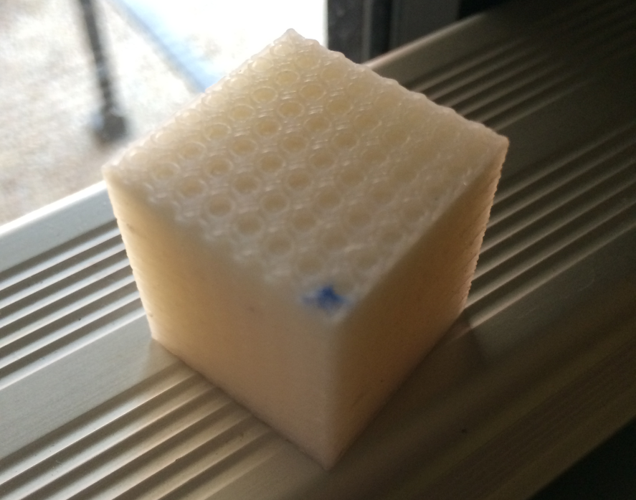
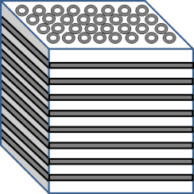
Future work: experiments with 3D printed models
3D printed cube with penny-shaped cracks.
Shear-wave splitting in both directions implies it’s slightly orthorhombic material.
(Huang et al., 2013)

Slide 11
Conclusions
Extended Gassmann’s equations for an orthorhombic medium
Shear rigidity and splitting are independent on fluid type, but not shear-wave velocity
Fluid substitution effects are anisotropic
Vertical P-wave velocity of low-porosity sands is constant with fluids
High-porosity gas sands or low-porosity wet sands, have more azimuthal amplitude variations

Slide 12
Acknowledgement
Allied Geophysical Laboratories, UH
Dr. Robert Sheriff and SEG Foundation
UH adjunct and research professors:
Dr. Leon Thomsen and Dr. Colin Sayers

Slide 13
Thank you!
Questions?

